Slide 1
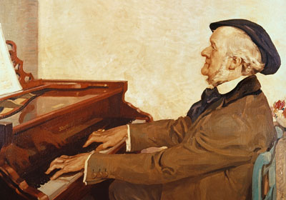
Wilhelm Richard Wagner

Slide 2
Wilhelm Richard Wagner
Born in Leipzig, Germany on May 22, 1813.
Died in Venice, Italy on February 13, 1883.
German composer, theatre director, polemicist and conductor primarily known for his operas.
Richard Wagner was one of the most important and ingenious composers of all time. He was also one of the most controversial. Known for his contribution to the genre of opera, Wagner is a giant of creative expression.
He believed it was his destiny to create the “work of art of the future” and tried inexhaustibly to create “Gesamtkunstwerk”, total work of art, which united all artistic forms, including music, poetry, dance, painting, and drama.

Slide 3
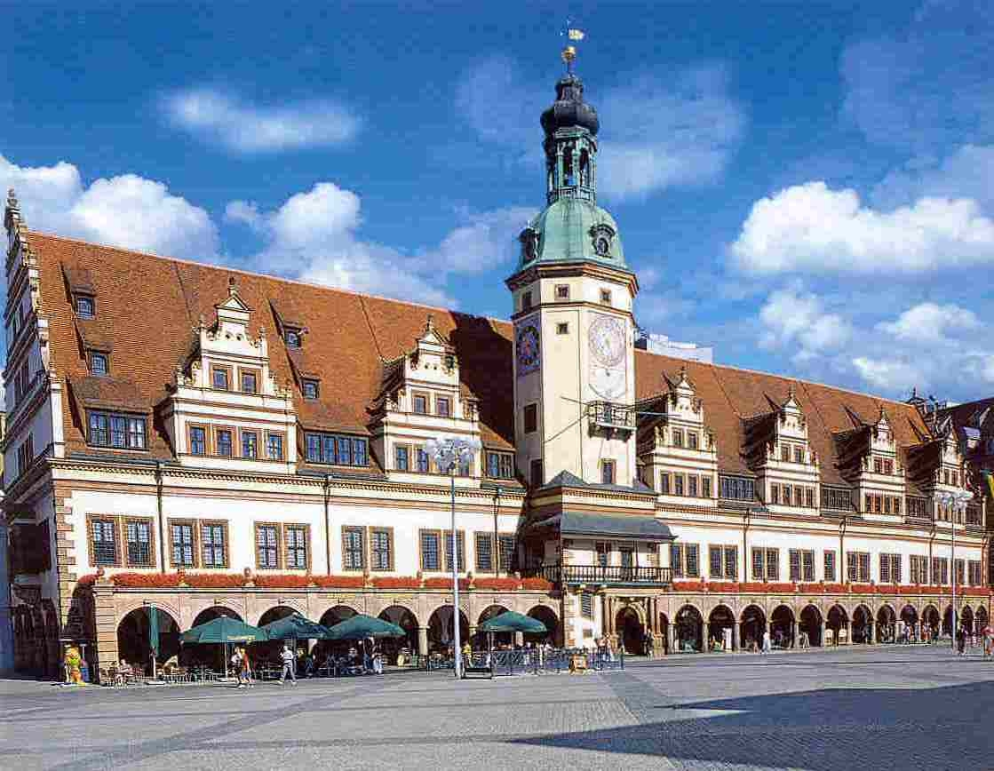
Education
Studied at the Kreuzschule, where his education began, he developed an ardent love for the Greek classics, and translated the first twelve books of the Odyssey, outside of school hours.
Studied at the Nicolaischule, where he begins harmony lessons.
He attends Leipzig University. Also studies music with Weinlig, and infatuation with Leah David.

Slide 4
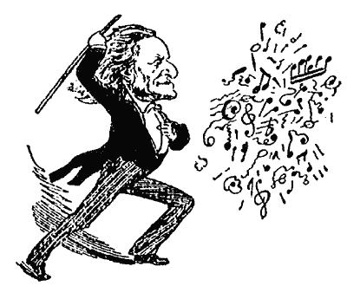
Composer
Initially establishing his reputation as a composer of works which were broadly in the romantic vein of Weber and Meyerbeer
Wagner wrote both the music and libretto for all of his stage works. He had his own opera house built, the Bayreuth Festspielhaus
During the composer's lifetime: German nationalism became a political movement, resulting in the Frankfurt Parliament in 1848-49, along with insurrections in several states of the German Confederation. Although the Parliament was suppressed, the unification of Germany under Prussian leadership (and without Austria) occurred in 1871.

Slide 5
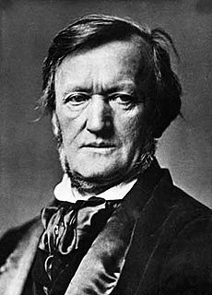
Composer
Wagner wrote his first opera, Die Feen (The Fairies), in 1833, but it was not produced until after the composer's death.
He was music director of the theater in Magdeburg from 1834 to 1836, where his next work, Das Liebesverbot (Forbidden Love), loosely based on William Shakespeare's (1564–1616) Measure for Measure was performed in 1836.

Slide 6
Composer
Wagner developed a compositional style in which the importance of the orchestra is equal to that of the singers. The orchestra's dramatic role in the later operas includes the use of leitmotifs, musical phrases that can be interpreted as announcing specific characters, locales, and plot elements; their complex interweaving and evolution illuminates the progression of the drama.
Influenced by Liszt, Franz.
His advances in musical language, such as extreme chromaticism and quickly shifting tonal centres, greatly influenced the development of European classical music. His Tristan und Isolde is sometimes described as marking the start of modern music.

Slide 7
Compositions
Wagner was well known because of his 13 operas and numerous other compositions but also because of his inevitable influence on our understanding of German culture and history.
Besides his activity as a composer and a librettist Wagner wrote an astonishing number of books and articles, in fact about 230 titles. The literary spectrum ranges from theories of opera to political programs.

Slide 8
First Opera
Die Feen (1833-34)
Characters:
Der Feenkönig, Ada, eine Fee, Zemina, Farzana, Feen, Arindal, König von Tramond, Lora, seine Schwester, Morald, ihr Geliebter, Gernot, im Dienste Arinalds, Drolla, Loras Begleiterin, Gunther, am Hofe von, Tramond, Harald, Feldherr im Heere Arinalds, Die Stimme des Zauberers Groma, Die beiden Kinder Arindals und Adas, Ein Bote, Chor der Feen, Chor der gefährten Moralds, Chor des Volkes, Chor der Krieger, Chor der Erdgeister, Chor der ehernen Männer, Chor der unsichtbaren Geister, Gromas
Location:
No specific time and place
Link to Act 1 http://www.youtube.com/watch?v=yHceTeWWbCM

Slide 9
Besides Opera
Wagner regarded himself as "the most German of men” and "the German spirit"
He composed 13 operas and numerous other compositions
He has been classified as an anarchist, a socialist, a proto-fascist, a nationalist, a vegetarian and an anti-Semite.
His name appeared in connection with almost all major trends in German history of the 19th and 20th centuries!
He wrote books and articles and around 10,000 letters

Slide 10
References
Deathridge John and Dahlhaus Carl. The New Grove Wagner. New York: Norton & Company, 1984. Print
Wagner. Tony Palmer. Tony Palmer Films. 2011. film.
Warrack, John. "Wagner, (Wilhelm) Richard." The Oxford Companion to Music. Ed. Alison Latham. Oxford Music Online. Oxford University Press. Web. 12 Dec. 2012. <http://www.oxfordmusiconline.com/subscriber/article/opr/t114/e7240>

