Slide 1
My Fast Obsession
Francisco Carrillo
CIS 1020-31
04/15/11

Slide 2
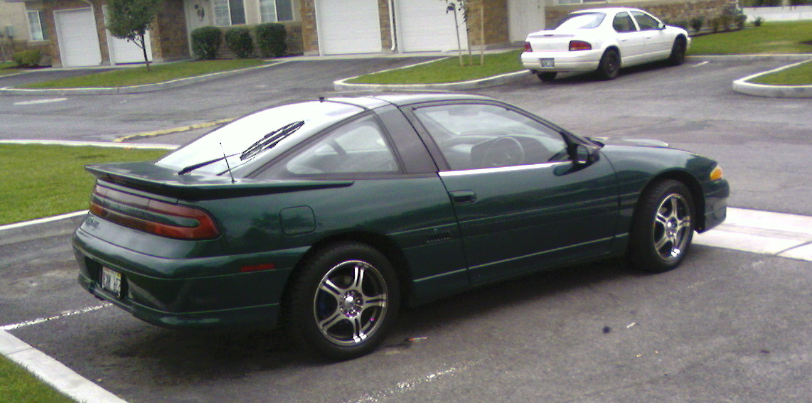
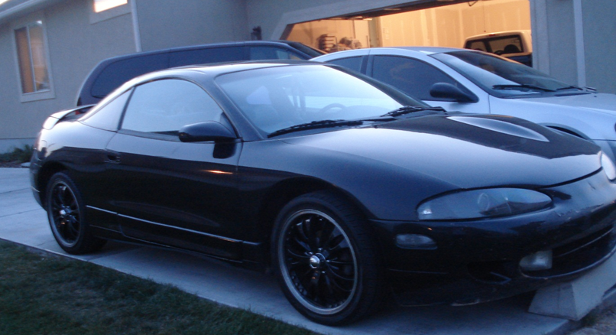
My High School Cars
Mitsubishi Eclipse GS
17” Rims
Exhaust
Intake
1996 Mitsubishi Eclipse GSX
18” Rims
3” Full Exhaust
TDO6 20G Turbo

Slide 3
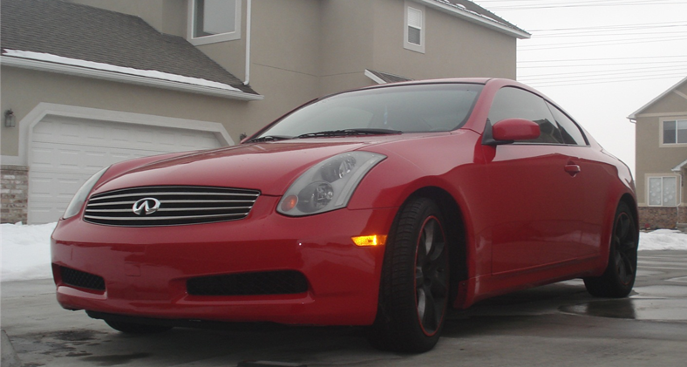



After High School Car
2004 Infiniti G35
17” Rims
Greddy Exhaust
HKS Intake

Slide 4
GS | GSX | G35
150 HP | 240 HP | 300 HP
2 Speeding Tickets | 3 Speeding Tickets | 5 Speeding Tickets

Slide 5
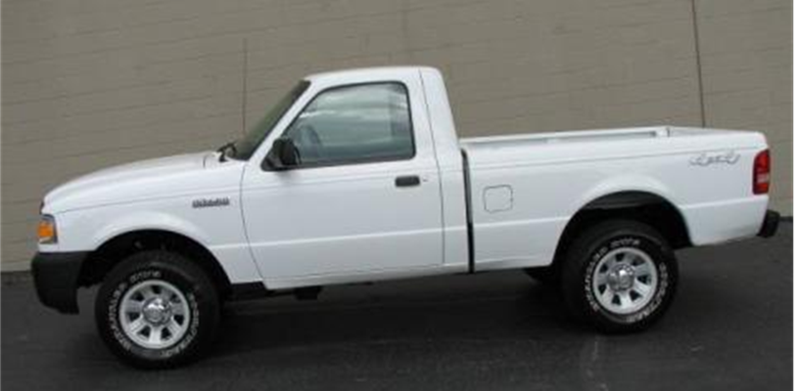
My College Truck
1994 Ford Ranger
Noisy Suspension
No Stereo
Very Slow
No Tickets

Slide 6
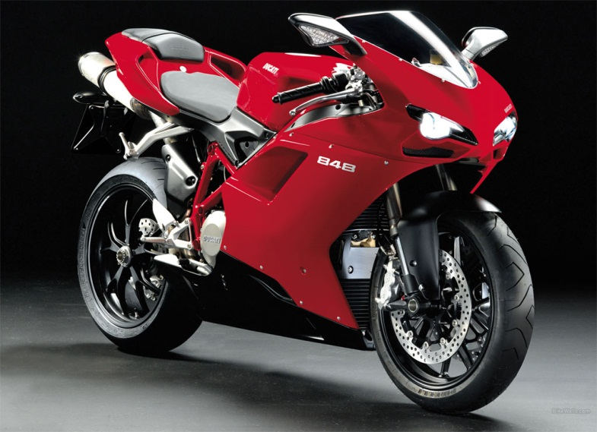
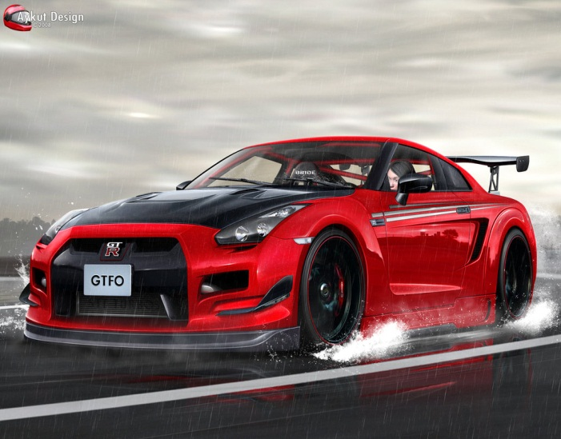
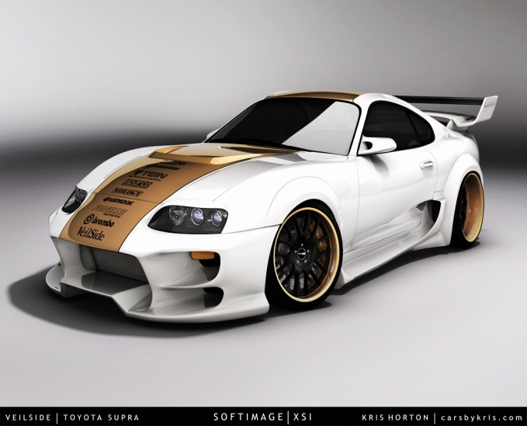
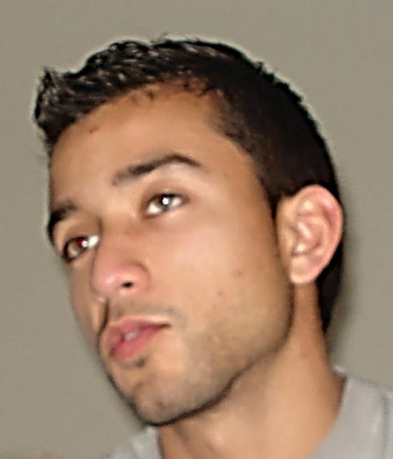
My “One Of These Days” Vehicle

